Slide 1
Introduction to Web-Development
HTML and Javascript
HTML – Slides 2-12
JavaScript – Slides 13-22

Slide 2

HTML Introduction
What is HTML?
How to make basic HTML document
Basic commands in HTML
How output is presented
Further applications of HTML

Slide 3
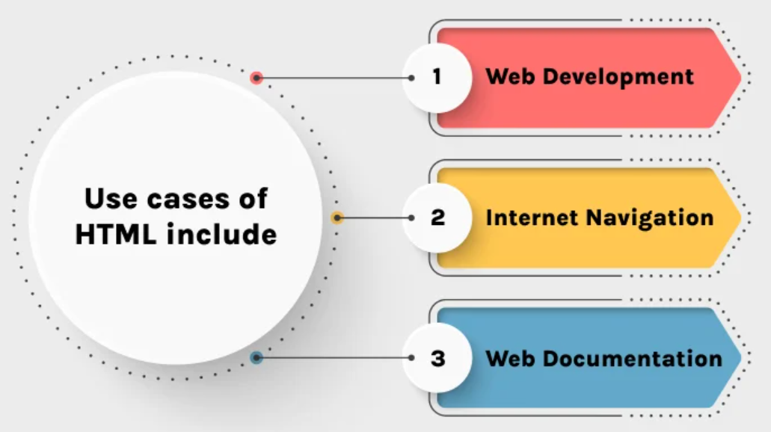
What Is HTML
Hypertext Markup Language
A beginner friendly language used for web design in addition to CSS (Cascading Style Sheets) and JavaScript
Main programming language of the Internet
Read top to bottom!

Slide 4
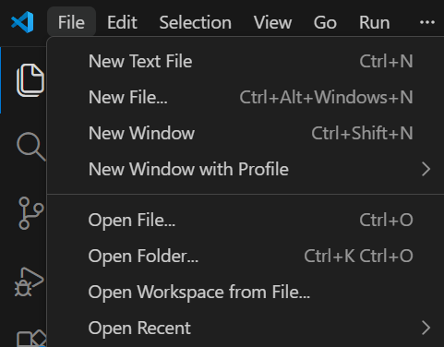
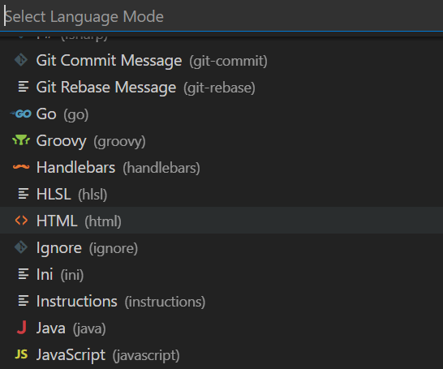
How to Create HTML Doc.
Open Visual Studio Code
Click “File” in top left corner
Click “New Text File”
Choose language as HTML

Slide 5
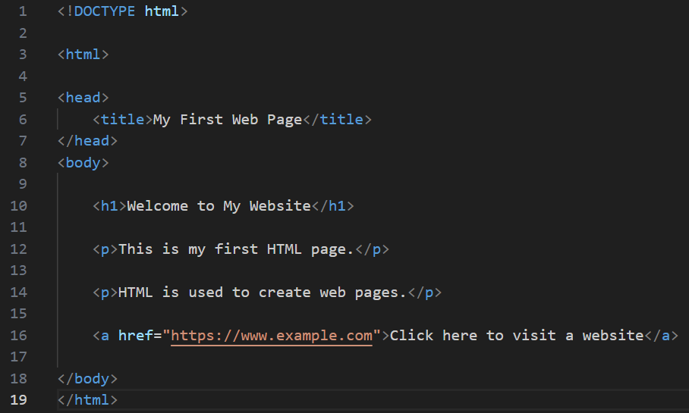
Commands Guide
Comments, <!DOCTYPE html>, and <html>
<head>, <title>, and <body>
<h1> and <h2>, etc., and <hr>
<p>, <a>, <ul>, and <li>
**CSS Commands

Slide 6
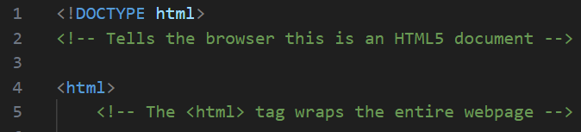
Comments, <!DOCTYPE html>, and <html>
Comments are formatted as:
  <!-- WORDS -->
  Allow you to write without it impacting your output
<!DOCTYPE html>: declares the file type to be HTML
<html>: begins the HTML page; must also be closed at the end of the file

Slide 7
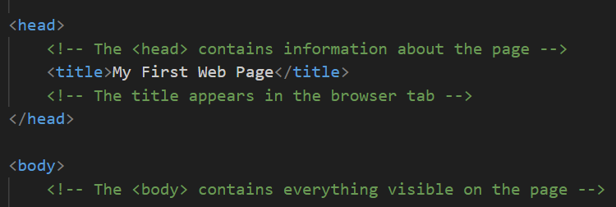
<head>, <title>, and <body>
<head> and </head>: creates section where page information can be declared
<title> and </title>: names the webpage tab
<body> and </body>: contains all the code for what is visible on the page; “body” of the document

Slide 8



<h1> and <h2>, etc. and <hr>
<h1> and </h1>: creates a header on the page
<h2> and </h2>, etc.: further headers or sub-headers for sections; new headers can be signified by increasing numbers
<hr>: horizontal line break
<br>: page break

Slide 9
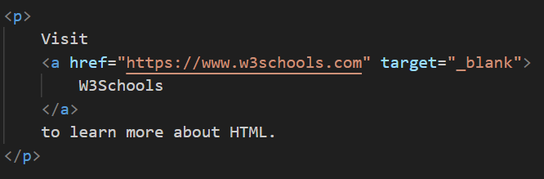
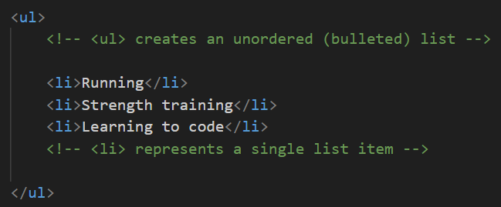
<a>, <p>, <ul>, and <li>
<a> and </a>: creates a hyperlink that can be clicked on within the webpage
<p> and </p>: creates a “paragraph”/line to be printed on the webpage
<ul> and </ul>: creates a list
<li> and </li>: creates bullet points within a list; are printed in the order they are typed

Slide 10
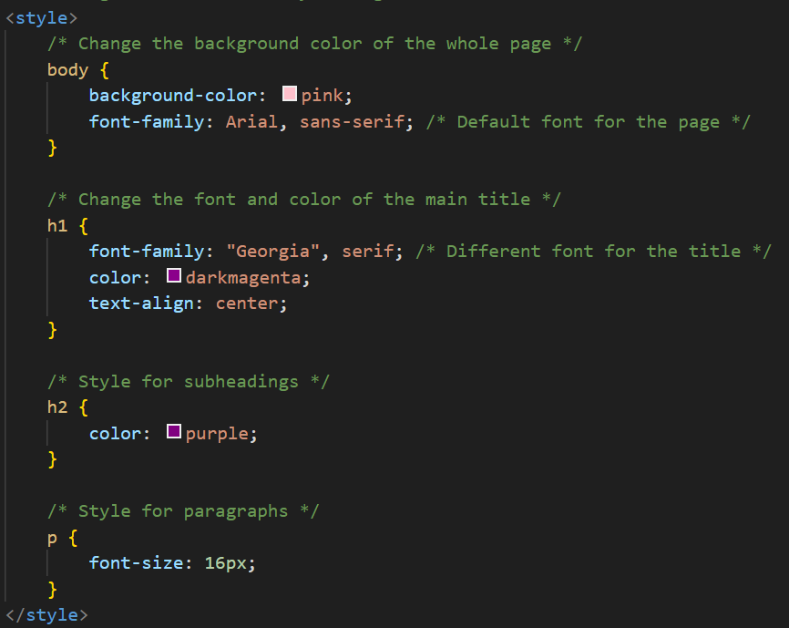
**CSS Commands**
<style> and </style>: creates the “block” of code which you can further edit the appearance of the webpage
body {_}: contains lines addressing the body of the page
h1 {_} and h2 {_}: addresses appearance of headers
<p>: addresses appearance of <p> lines

Slide 11
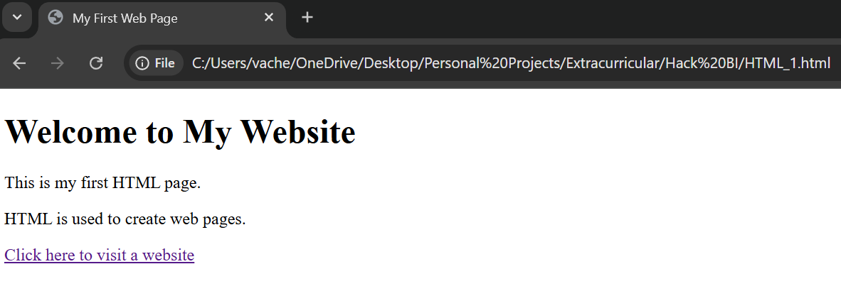
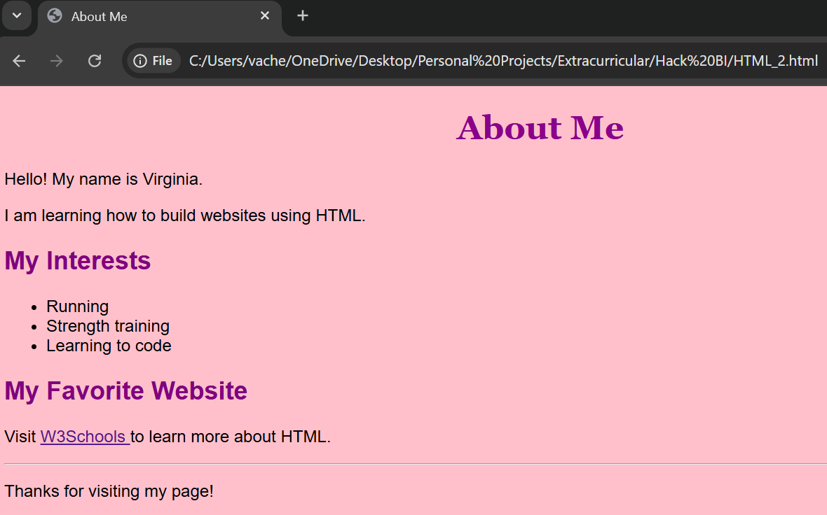
Output
Click the “Run” option in the top left
Choose “Run Without Debugging”
You will be prompted to choose from different options to open your webpage:
  We recommend choosing your browser, so most likely Chrome or Edge

Slide 12
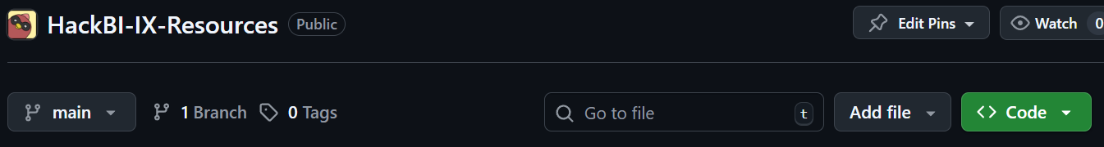
Further Applications
Websites cannot be published without purchasing a domain, BUT…
They can be shared through websites like GitHub, which you can upload your code to share with others!
As was said earlier, HTML is a great basis for further website development.
Come to the JavaScript workshop to learn more :p!

Slide 13
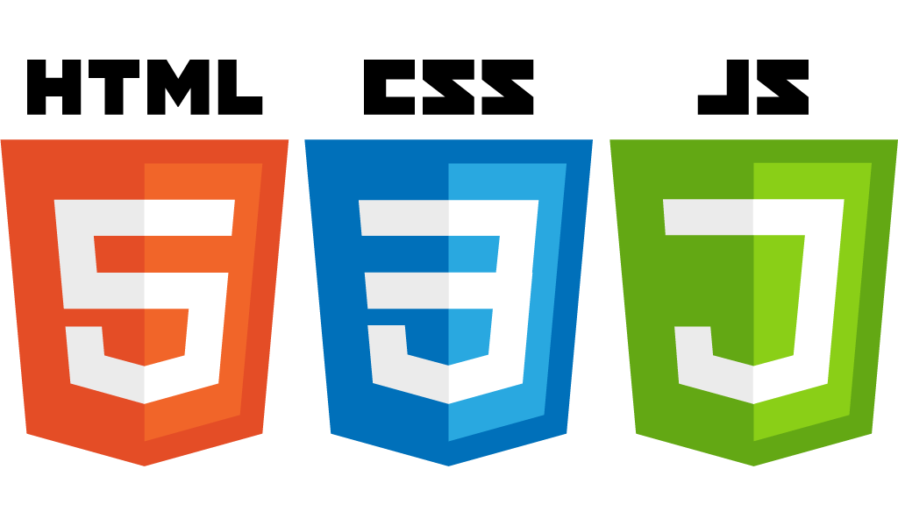
JavaScript Introduction
What is JavaScript used for?
How to make basic HTML/JavaScript document
Basic commands in JavaScript
How output is presented
Further applications of JavaScript

Slide 14
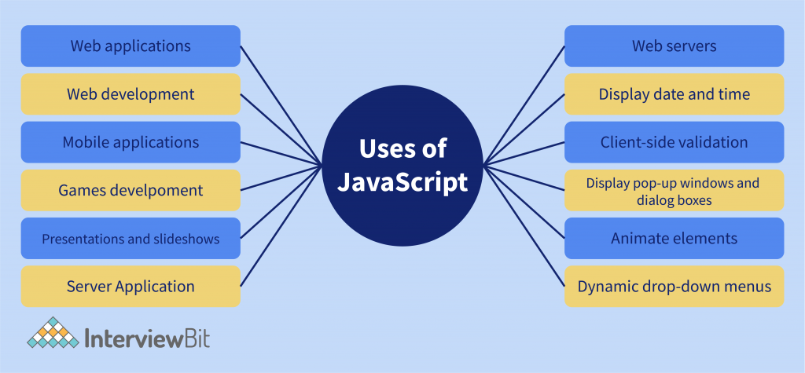
What is JavaScript Used For
JavaScript is a programming language associated with web design, but can stand on its own
HTML provides a base for JavaScript and CSS (Cascading Style Sheets) to build on
  Makes “prettier”/actual appearance vs. function

Slide 15
How to Make JavaScript Doc.
Open Visual Studio Code
Click “File” in top left corner
Click “New Text File”
Choose language as HTML
You can do a JavaScript only file, but we are using it to build off HTML due to their common use together!

Slide 16
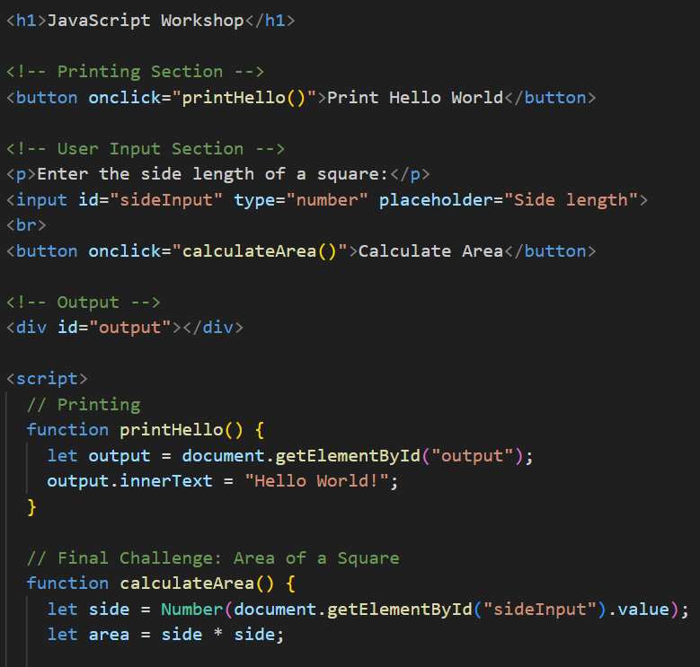
Command Guide
<button> and <input>
<script>
let _ = _
Functions!!!

Slide 17
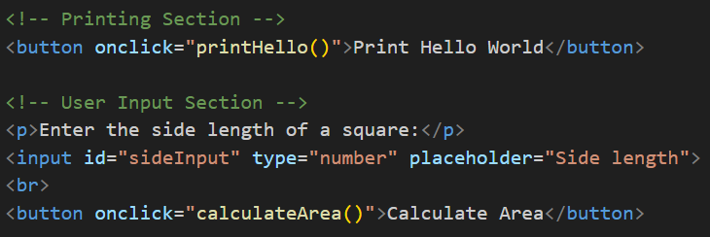
<button> and <input>
<button>: can be used to reset or submit a form, as well as trigger JavaScript code (like it does in our program)
  It triggers the functions “printHello” and “calculateArea”
<input>: declares where a user can put input, as well as what type of input it is (number, word, etc.)

Slide 18
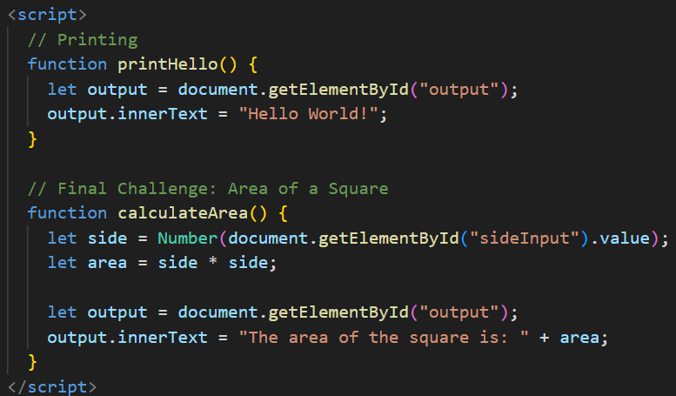
<script>
<script>: allows us to input JavaScript code into HTML
  By inputting JavaScript, we can make our output be more interactive and dynamic!
  Can also be used to import images
  Must be closed at the end

Slide 19
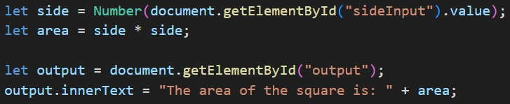
let _ = _
let _ = _: declares what a variable will be valued as
  Fundamental + very important command for everything but specially making functions!

Slide 20
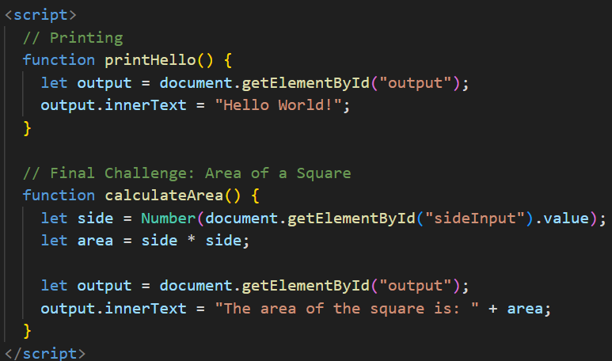
Functions
Functions:
  Repeatable blocks of code that can be called multiple times in multiple places
  More “flexible” than functions in Java or other traditional coding apps

Slide 21
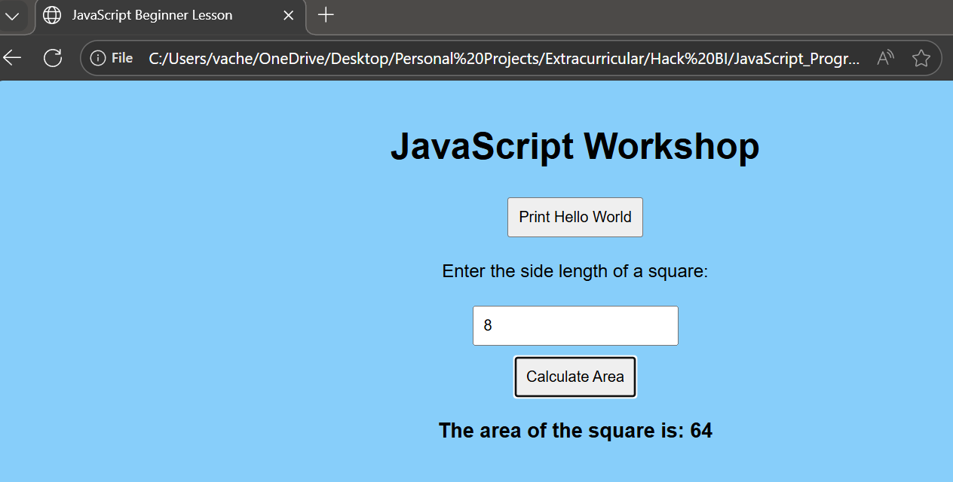
Output
Click the “Run” option in the top left
Choose “Run Without Debugging”
You will be prompted to choose from different options to open your webpage:
  We recommend choosing your browser, so most likely Chrome or Edge

Slide 22
Further Applications
JavaScript can be used on its own, as its own coding language
JavaScript is used throughout the world to better design interactive websites, software, and apps
Can be shared through GitHub!!

Slide 23
Thank you for attending Intro to Web-Development!
Happy coding everyone!!!

